Slide 1
Work Allocation
Group Member
Duty
Contribution
Chen Anqi
Business scenario analysis
14.00%
Wu Jun
Data collection, preprocessing and EDA
14.10%
Huang Zhijun
Machine learning
14.20%
Wei Yuhan
CNN (ResNet18, ResNet34, & ResNe50)
14.30%
Liu Jingwen
LSTM (time series), MLP & MLP with dropout
14.40%
Yan Ge
VGG16, VGG16_bn, VGG19 & InceptionV3
14.45%
Guo Xinglin
LSTM, MLP and machine learning
14.55%

Slide 2


MUSIC Gerne Classification

Slide 3


Agenda
Scenario
Solution
Impact
Mitigation
Summary

Slide 4
Agenda
Scenario
Solution
Impact
Mitigation
Summary

Slide 5

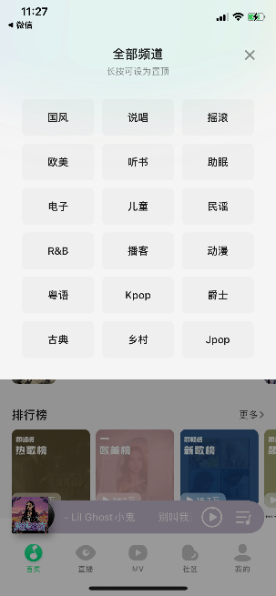
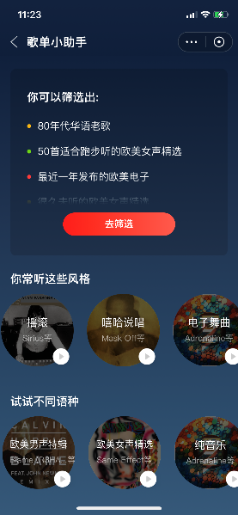


The Application of Music Labelling
Searching
Recommendation
Users use labels to find specific type of music.
Stream platforms use labels to produce user portrait and recommend music accordingly.

Slide 6
Standard Practice
Traditional Solutions
Potential Risks
Problems to Solve
Artists
Artists attempt another genres
Low accuracy
Music publishers
Label with popular but unmatched genre for exposure
Data labelers
No available crowdsourcing service
Labor costs
Inefficient and expensive

Slide 7
Agenda
Scenario
Solution
Impact
Mitigation
Summary

Slide 8
Dataset Generation
30s Audio Tracks
N = 1000
Mel Spectrograms Image
N = 1000
Split
3s Audio Tracks
N = 9990
MFCC Time Series
N = 9990
Numerical Music Features
N = 9990

Slide 9
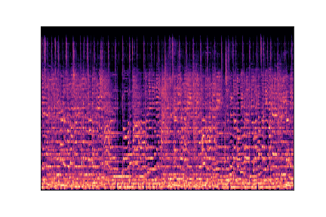




Image, Time Series, Numerical Inputs
Mel Spectrograms
MFCC
Music Features
Tempo
Zero crossing rate
Harmony
···
MFCC

Slide 10
Models for Different Data
Images
Time Series
Music Features
CNN
RNN
RNN
ML
MLP
VGG16
VGG16_bn
Inception-v3
ResNet18
ResNet34
ResNet50
LSTM
INPUT
Hidden (ReLU)
×3
Dropout
···
OUTPUT

Slide 11
Model performance
MLP with dropout trained on Music Features Dataset is the BEST.

Slide 12
Agenda
Scenario
Solution
Impact
Mitigation
Summary

Slide 13
Marginal Improvement
Images
Time Series
Musical Features
Acc 93%
MLP with drop out
Acc 10%
Acc 10%
Segment data
&
Feature Extraction
Multiple features
&
More information
Shallow layers
&
Well trained model

Slide 14
Cost Reduction & Efficient Improvement
Human
Algorithm
High
Interns or outsourcing companies
Low
Equipment maintenance
HR demand
High
30 secs per song per person
Low
500 songs per second
Time cost
$
High
Limited to efficiency
Medium
Maintenance cost + Algorithm price
Capital cost
High
15,000 times faster
Save 2,000,000 CNY
*According to detailed assumptions.

Slide 15
Agenda
Scenario
Solution
Impact
Mitigation
Summary

Slide 16
Further Improvements
Limitations
Mitigation plan
Limited feature numbers
General genres
Uni-label classification
Genre-based classification
Data enrichment
Extract more features, feature importance analysis
More detailed labels,
e.g. funk, garage rock, hard rock…
Multi-label deep learning
Content-based classification,
e.g. Lyrics analysis
Dimension
diversification

Slide 17
Agenda
Scenario
Solution
Impact
Mitigation
Summary

Slide 18




Automatic Music Genre Classifier
Scenario
Misclassification on music genre
Expensive and time-consuming manual labelling
Solution
Enlarged sample + Music features + MLP
Impact
93% Accuracy Cost 37.5% Efficiency 15,000x
Mitigation
Data enrichment
Classification Dimension Diversification

Slide 19
Thanks for your Listening!

